Slide 1

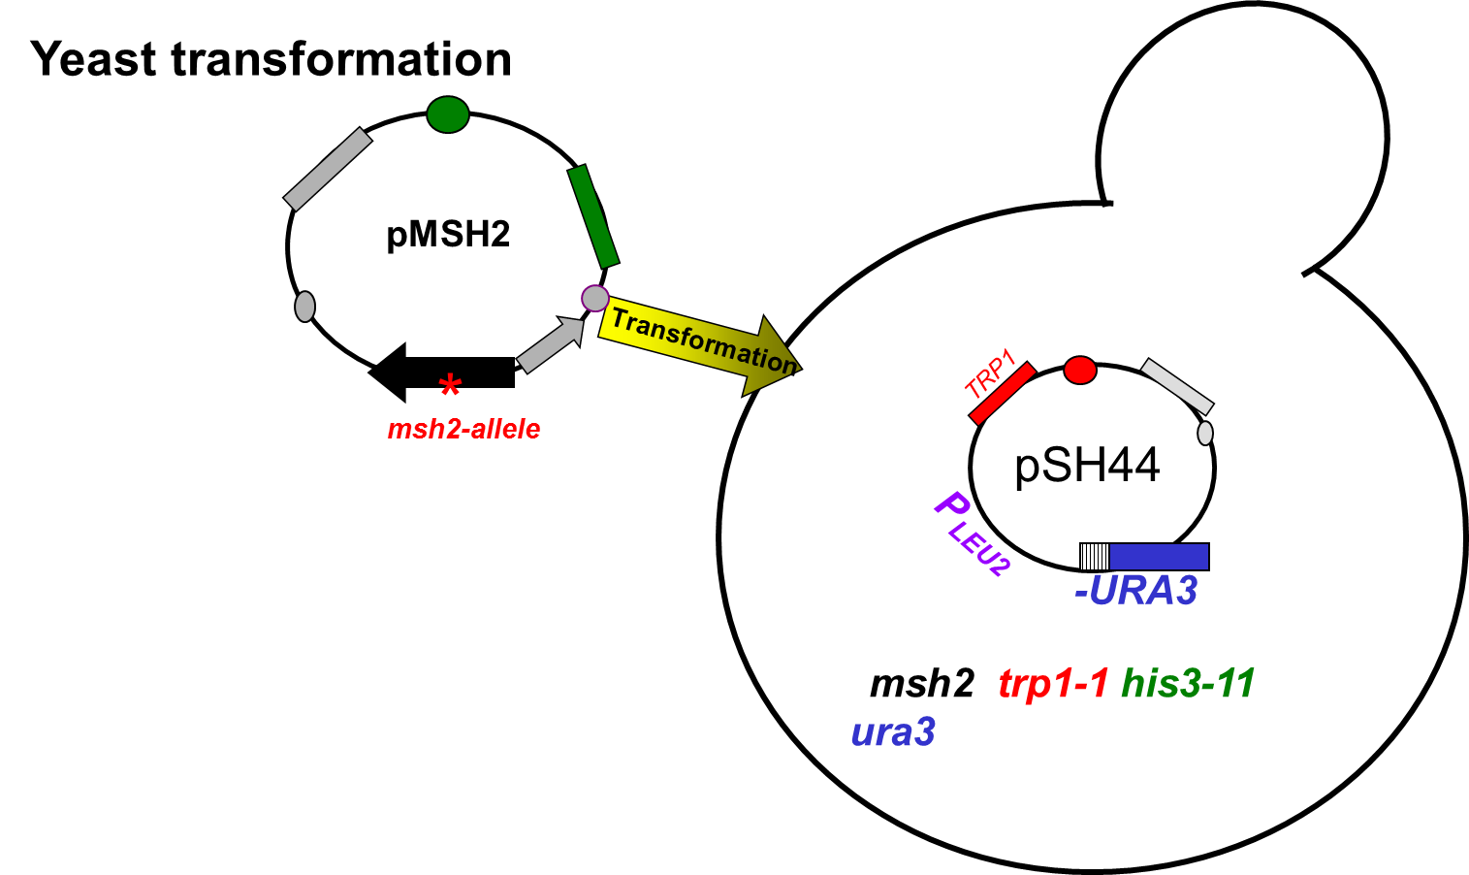
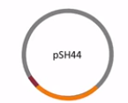
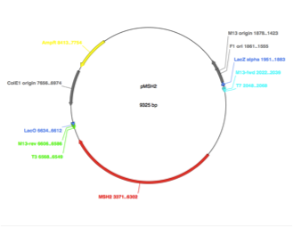
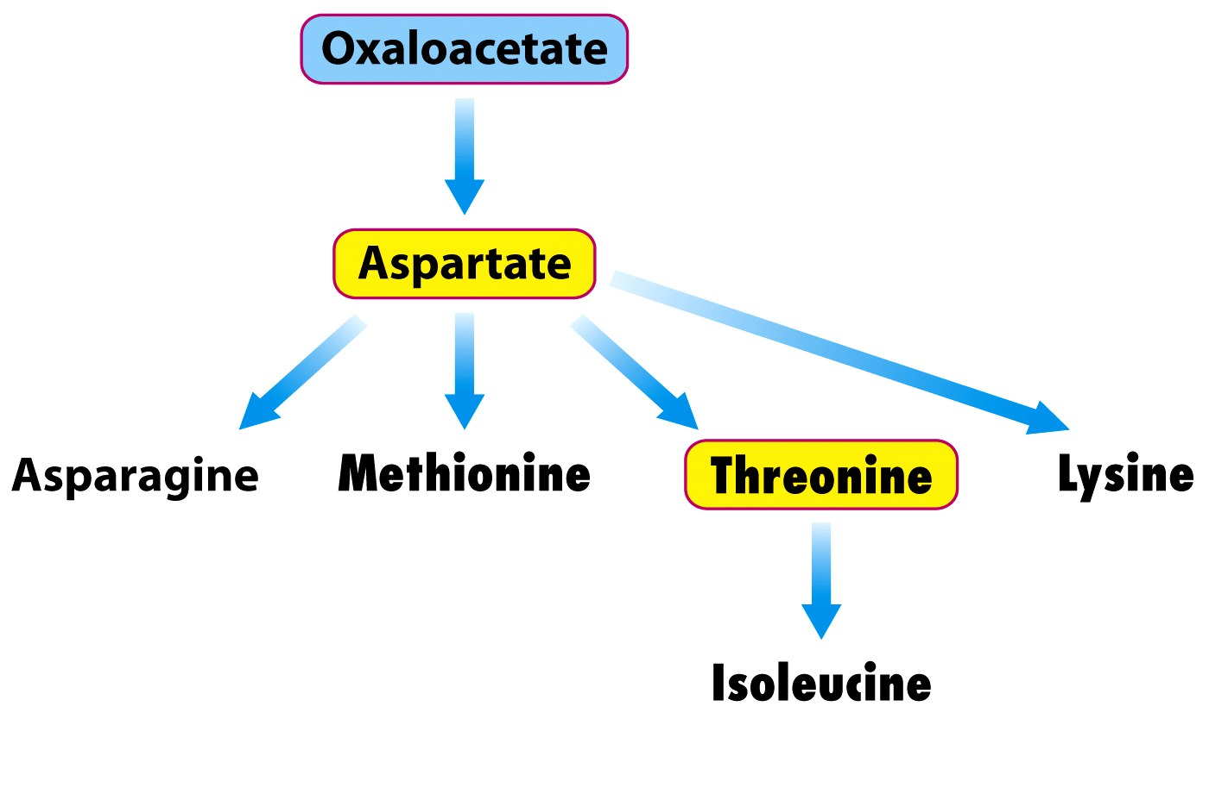
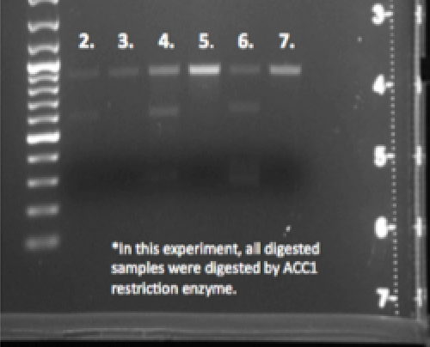
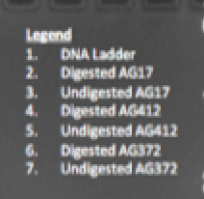
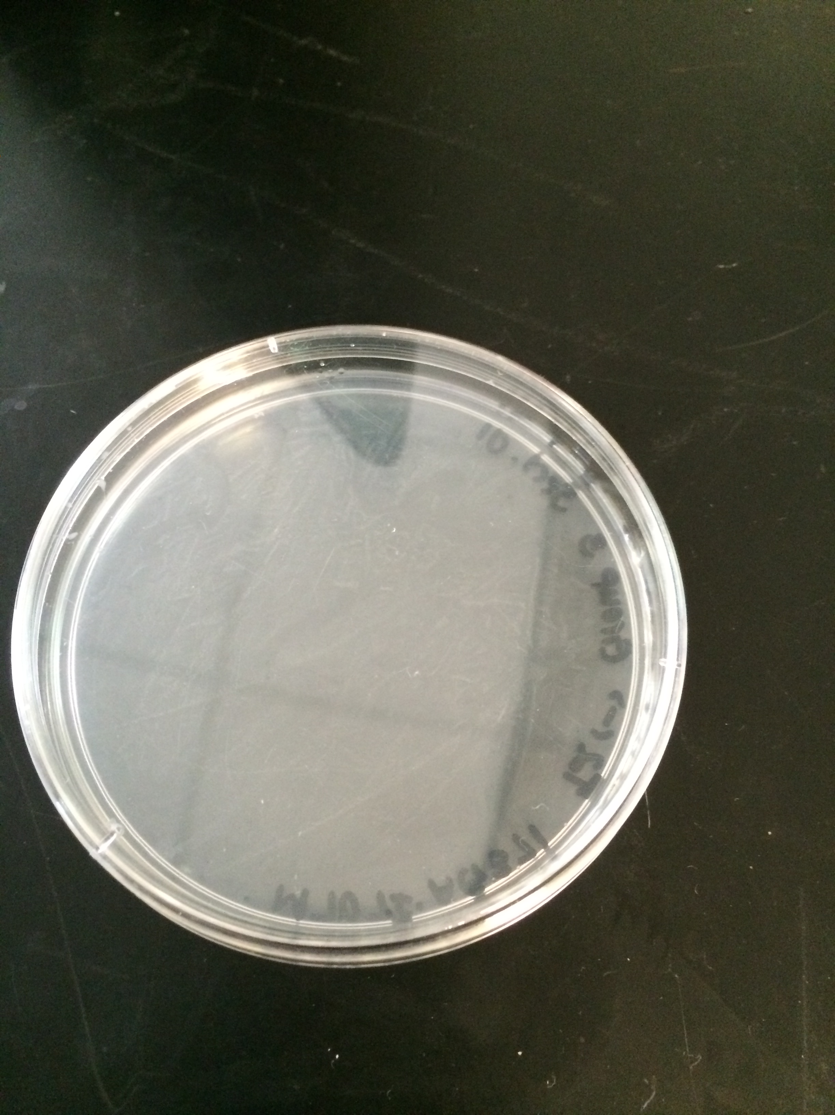
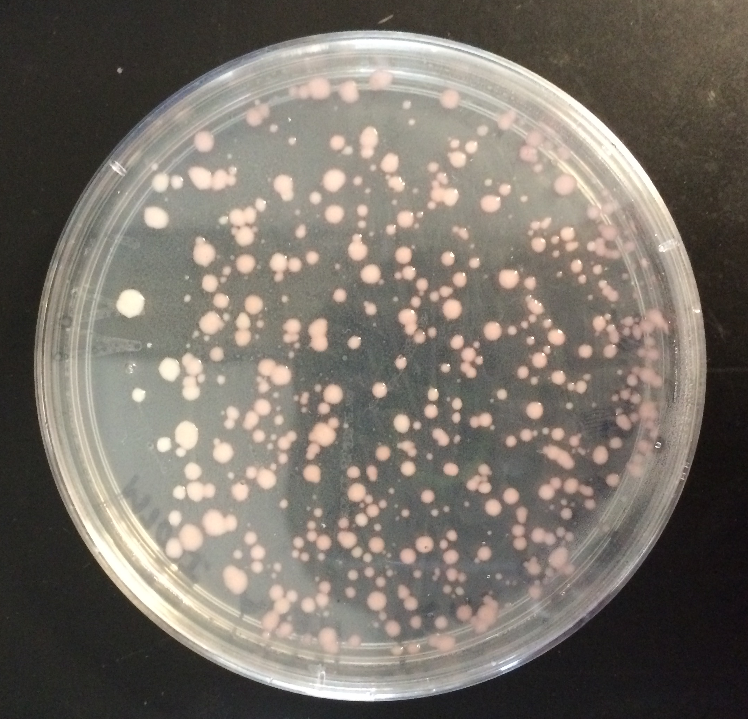
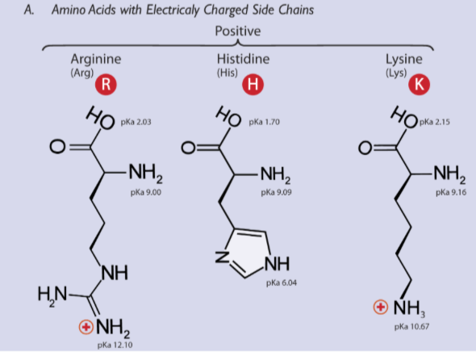
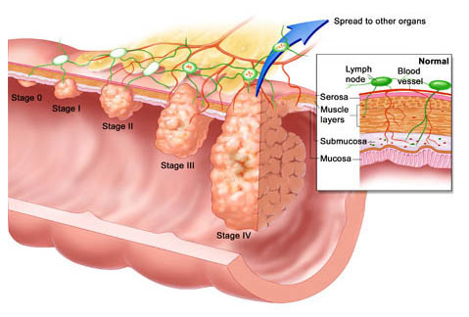
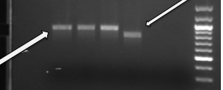
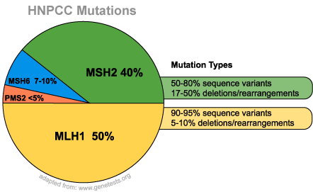
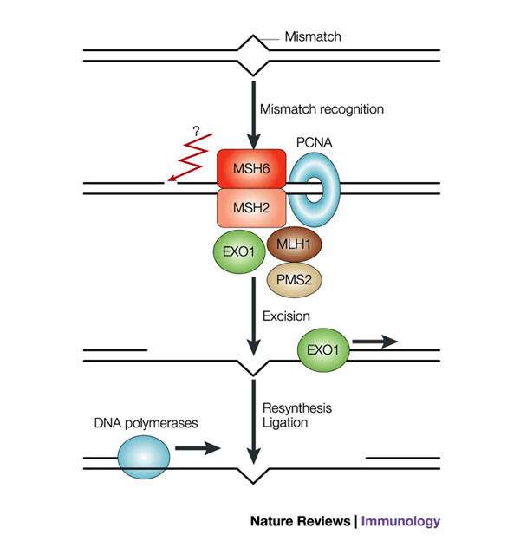
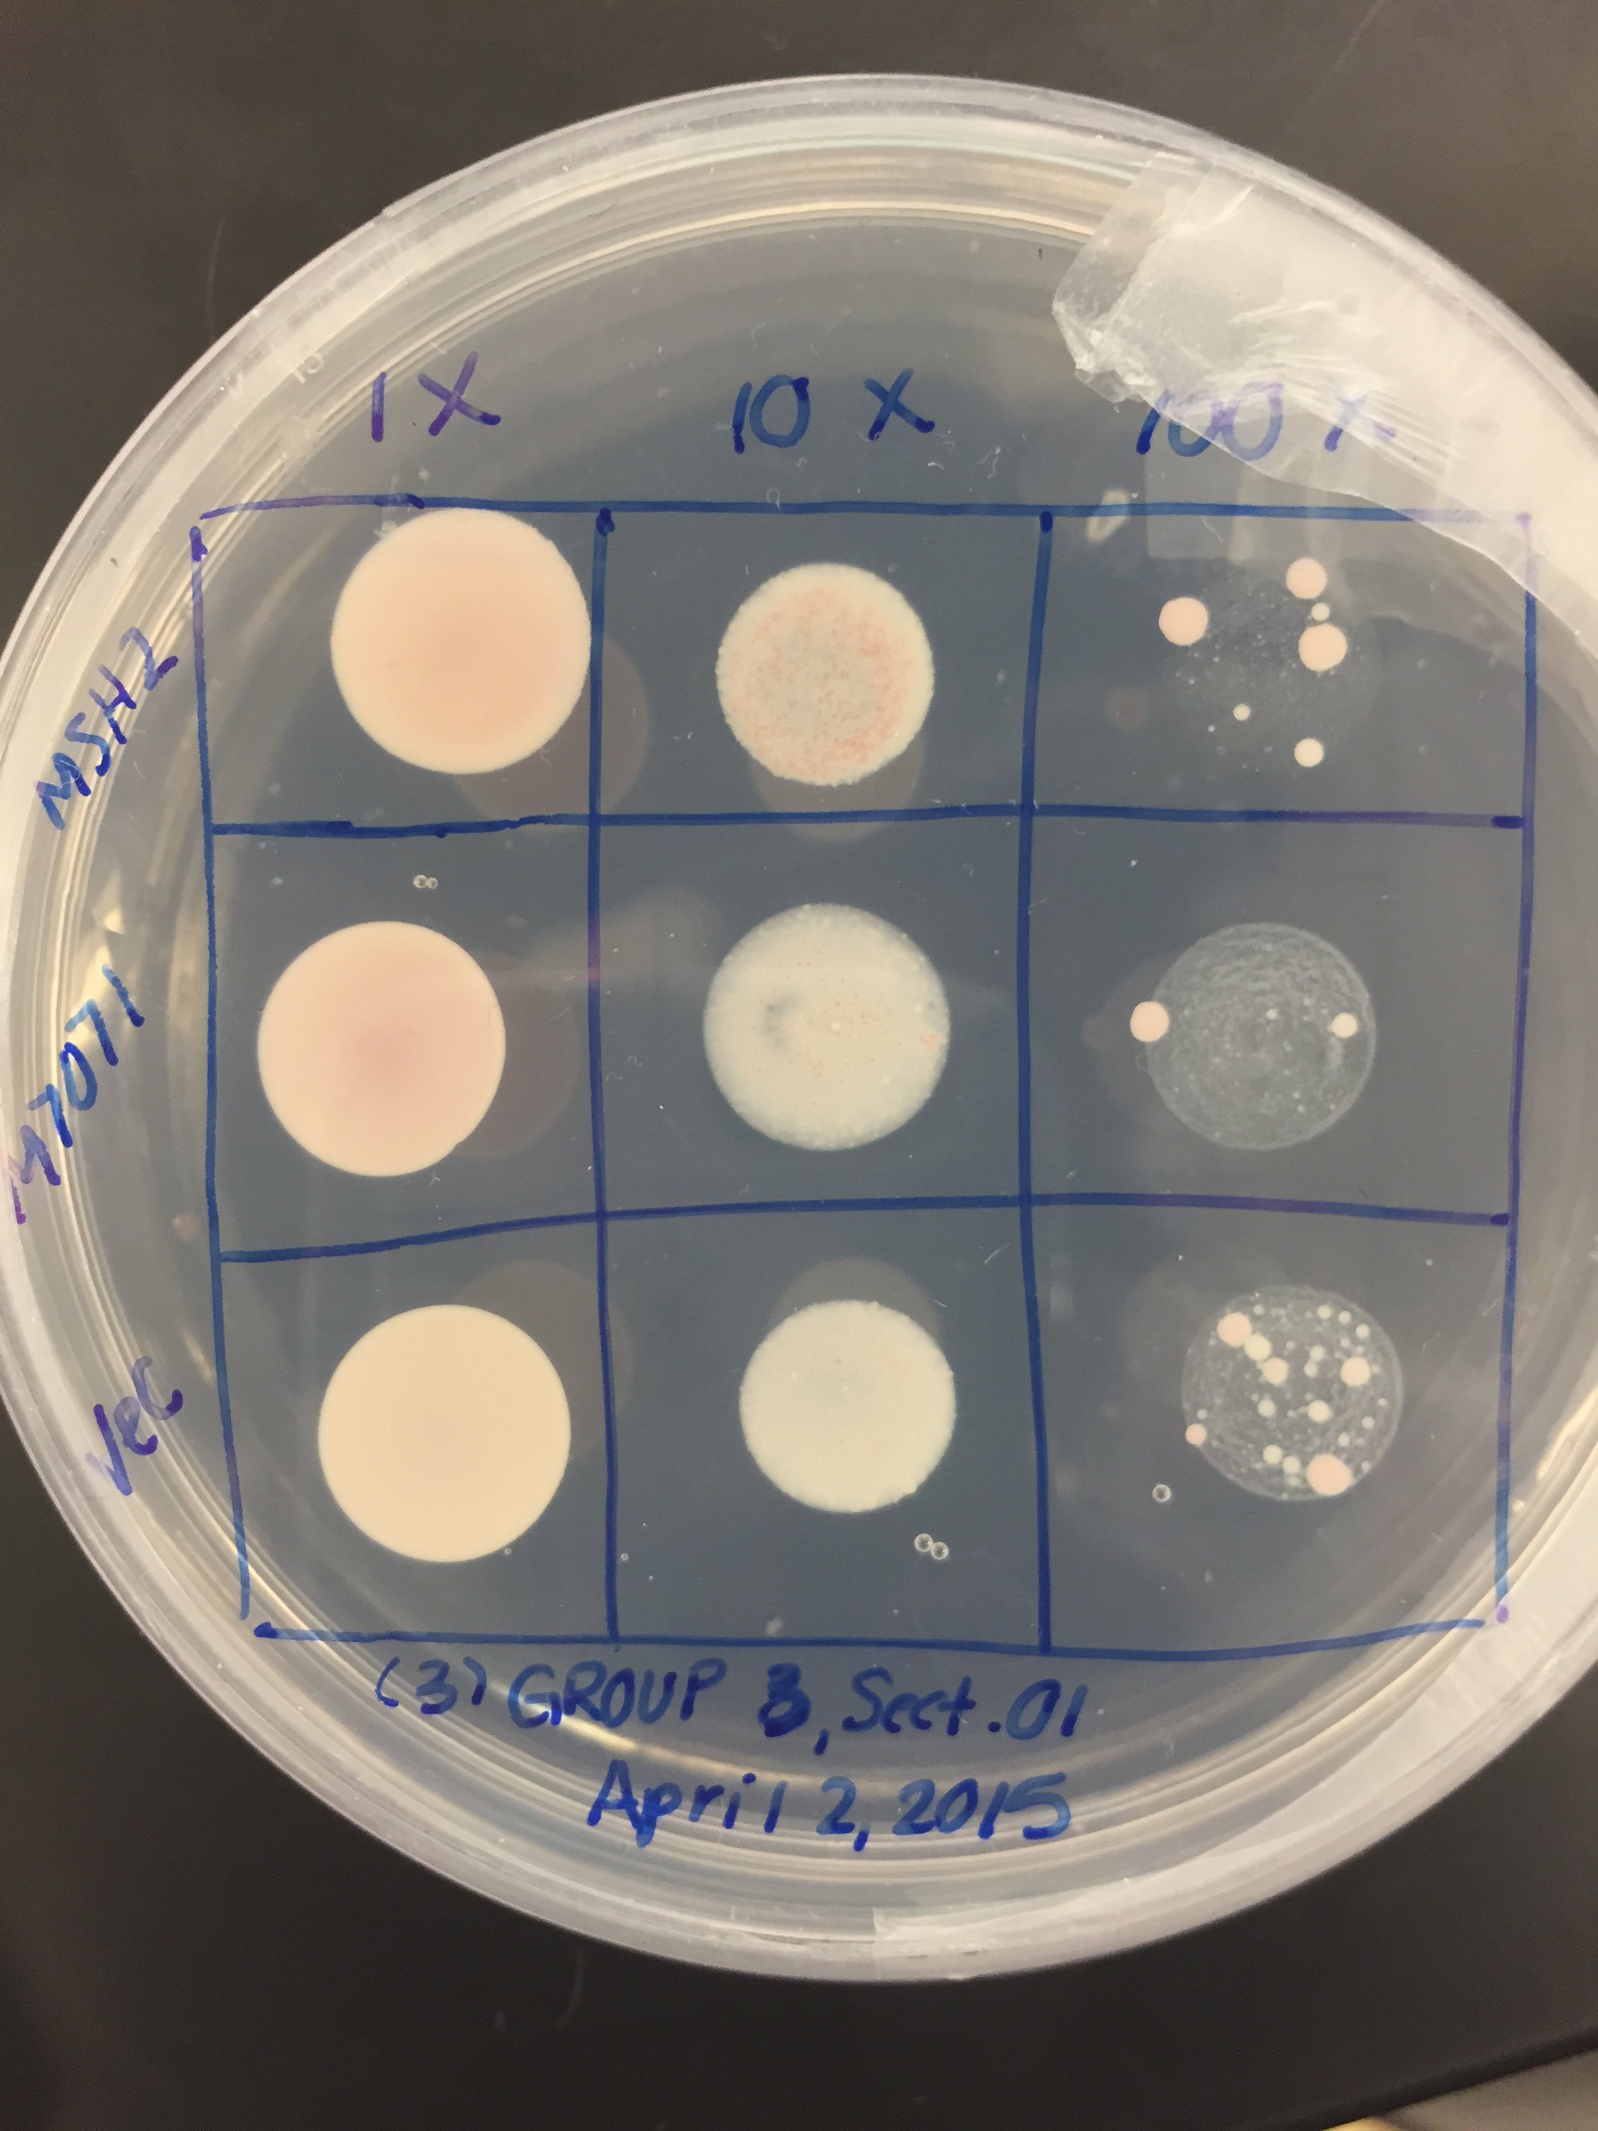
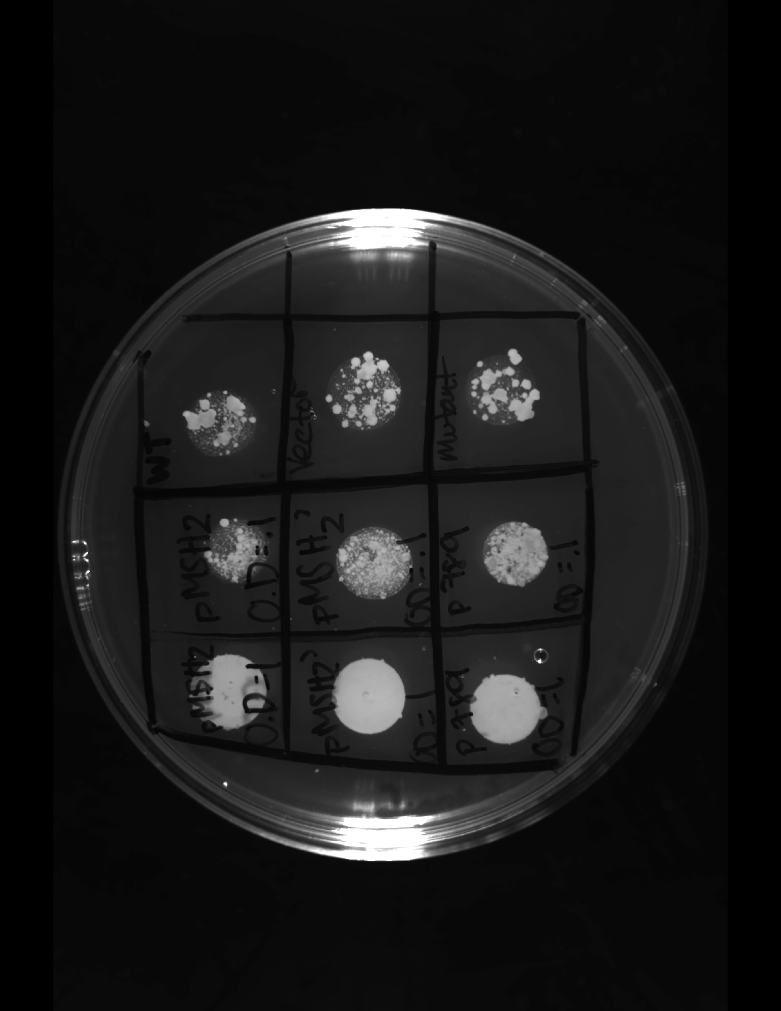
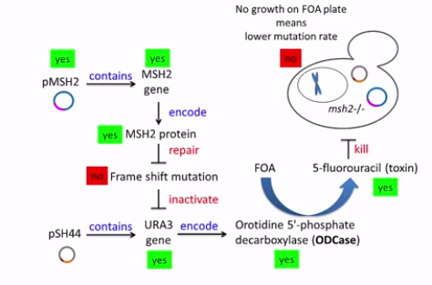

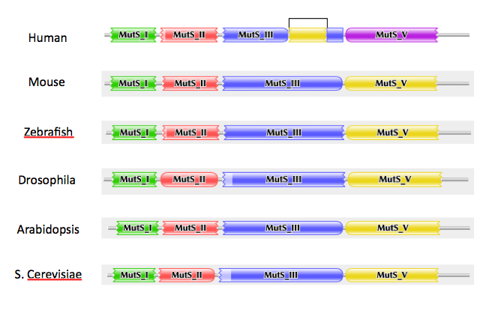
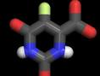
Functional Studies of the Human MSH2 Missense Mutations in Yeast Provide
Insight to Hereditary Nonpolyposis Colorectal Cancer
Analysis of H658R and M718I Missense Mutations In An MSH2 Yeast Model
Jasmin Eatman and KayCei Moton-Melancon
^{Advisor: Dr. Hong Qin}
Department of Biology, Spelman College, Atlanta, GA 30314
Abstract
Materials and Methods
Conclusions
Although cancer is a monumental ailment that impacts many populations throughout the globe, major advances in biotechnology have aided in research and treatment of many different types of cancers. Hereditary Non-Polyposis colorectal cancer is caused by a gene mutation or is oftentimes inherited within families, resulting in the development of colorectal cancer. One of the major genetic mutations that is linked to HNPCC is a missense mutation in the MSH2 gene that encodes for proteins that are central to mismatch repair mechanisms. Through this experiment, our goal is to determine the effect of H658R and M718I missense mutations caused by single nucleotide polymorphisms (SNP) in MSH2 by determining the mutation rate of Saccharomyces Cerevisiae transformed with pMSH2’ mutant plasmid carrying a SNP. We conducted this experiment using a yeast model in order to understand the function of MSH2 gene in tumor suppression. In order to identify the effects of the frameshift mutation resulting from the SNP, DNA, a reporter plasmid design was utilized consisting the reporter plasmid GT 16.5 pSH44 and URA3. In order to calculate the mutation rate produced by the mutant plasmids, 5-ﬂuororotic acid monohydrate (FOA) dinucleotide instability plate assays reported mutation by resulting in the formation of 5-FU that would result in yeast death without the ability to repair mutation. In the determination of the impact of Single Nucleotide Polymorphisms, the function of MSH2 in tumor suppression may lead to the development of indicators that aid in early detection of HNNCCP .
Transformation of Saccharomyces Cerevisiae
(GT)16.5-URA3: the reporter gene
Plasmid map of pMSH2 (WT)
Fig.6 Shows the nature of the mutation of M718I which turns from Methionine to Isoleucine
The specific locations of mutation in the modified or mutant genes on plasmid AG372 and AG 379 are M718I and H658R. These locations were identified by aligning the mutant and wild type sequences in ClustalW2 alignment software.
It can be concluded from the FOA plate of Mutant M718I
that it preforms similarly to to the Wild Type. From this observation
it can be concluded that the SNP mutation is less severe, and that
normal functioning MSH2 is still present in some degree.
This observation was different than what we expected based on the amino acid properties of the two. However the results can be explained based on Methionine not being in the very beginning of the coding sequence as well as an inaccurate cell count.
Results
PCR and Restriction Enzyme Analysis
Transformation of MSH2
ACCI (H658R)
BLANK
SD-HIS-TRP
Introduction
Fig1. As predicted the the digested mutant (2) yielded 2 bands and the mutant (6) yielded the highest number of bands. This allowed for the identification of the mutant.
Hereditary Nonpolyposis Colorectal Cancer
HaeIII Digestion (M718I)
Uncut, Mutant
Uncut, WT
Size Ladder
Cut, Mutant
Cut, WT
Fig3. (left) Growth plate lacking Histidine and Triptophane that are necessary for the yeast growth. Yeast without reporter plasmid cannot grow. (right) Mutant msh2 transformed with pSH44 reoprter plasmid incorporating His and Trp selection markers. These yeast cells transformed by the plasmid with His/Trp adopt the ability to be expressed which allows cell growth.
Fig7. The mutation of H658R is the change from Histidine to Arginine.
Based on the FOA plate there were several colonies that survived signifying the absence of the FAO which kills the colonies. Thus, we can conclude that The H658R mutation is very sever and has behaviors similar to the empty vector. This also means that there is no MSH2 functionality and the switch from Histidine to Arginine is lethal.
For future investigation, we would have a constant cell count as well as redoing the entire experiment to confirm the severity of each mutation.
MSH2 is a major cause
of HNPCC
Fig2. PCR fragments generated through digestion with restriction HaeIII. HaeIII cuts wild type, displaying two bands. This restriction endonuclease cut pattern allows for the identification of mutant MSH2 in AG371 plasmid.
Conserved MMR between Human and Yeast
FOA (M718I)
FOA (H658R)
Assessment of mutation in URA3 using FOA plates
Implication in Human MSH2 Mutations
MSH2
MSH2
Fig4. M718I (left), Appears to be a low colony count in 100X wild type section, however there is no conclusive evidence that this is a result of frameshift repair by MSH2 protein. Initial cell count uncontrolled.
H658R (right) There is a high colony count for the mutant as well as the vector, however there is a low counts for the Wild Type. This is conclusive based on the evidence of the knowledge of the H658R.
Mutations in
human MSH2
Mutant
Vector
?
Vector
Mutant
Interventions
(Overexpression)
Mutations in yeastMSH2
chromosome: mshΔ
trp1-1
his3-11,15
Functional Studies
Based on the concluding FOA assays the mutant M718I its SNPs is not likely to contribute to Nonpolyposis Colorectal Cancer based on retaining some MSH2 functionality. However based on the severity of H658R and its SNP Hereditary Nonpolyposis Colorectal Cancer is very likely.
Conserved MSH2 between Human and Yeast
chromosome: msh2Δ
trp1-1
his3-11,15
References
TRP1/ARS
Gammie, A. E., and N. Erdeniz. “Characterization of Pathogenic Human MSH2 Missense Mutations Using Yeast as a Model System: A Laboratory course in Molecular Biology.” Cell Biology Education 3.1 (2004): 31-48. Print
Gammie, A. E., and N. Erdeniz. “Functional Characterization of Pathogenic Human MSH2 Missense Mutations in Saccharomyces Cerevisiae.” Genetics 177.2 (2007): 707-21. Print.
Qin, Hong. "Restriction Enzyme Analysis of a Plasmid, PMSH2, XbaI
ApaI." YouTube. 10 Mar. 2015. Web. 12 Apr. 2015.
HIS3
P_{LEU2}
pSH44
CEN11
mutagenized
(GT)_{16.5}-URA3
Experimental Objective
*
X
This experiment’s primary objective is to gain insight on the effects of MSH2 genetic mutation in tumor suppression that may instigate the development of HNPCC in humans.
Msh2-H658Y
X
X
5FOA
FU
Acknowledgements
Fig5. (left) If SNP does cause frameshift mutation, yeast will survive because FOA will not be toxic through ODCase. (right) If SNP does not cause a SNP that results in a frameshift mutation, FOA assay will be made toxic by ODCase enzyme and kill yeast cells.
Dr. Hong Qin, Dr. Stephen Kioko, and all of our classmates for being of great help and support throughout the semester.

